Slide 1

Advanced RADIUS implementation and uGuest User and Guest Wi-Fi Authentication in a Dockerized Landscape
Kostas Kalevras, DevOps Engineer, GUNet

Slide 2

Agenda
RADIUS
Institution needs
GUNet RADIUS
uGuest

Slide 3

RADIUS Needs
Service Stack
Wi-Fi
SP (on premises Wi-Fi)
IdP (Eduroam)
VPN
Integration with IDM
CAT profiles
Log Visualization

Slide 4
GUNet RADIUS service
IDM integrated
Full protocol stack (PEAP, TTLS-PAP)
Wi-Fi + VPN integration
Dockerized installations
Full CI/CD pipeline
Rapid development / deployment
GUNet managed
CAT profiles
Server certificate CA
Log visualization (uSIEM)

Slide 5
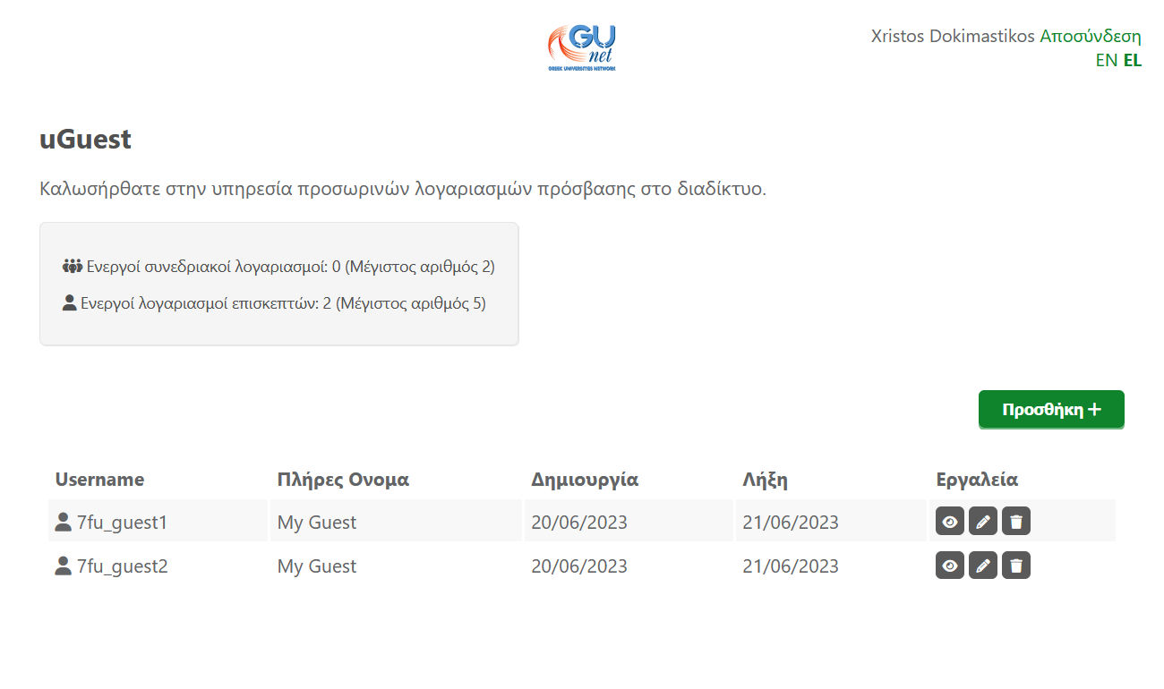
uGuest web interface
IDM integrated
Temporary guest / conference accounts
Automatic lifecycle management
LDAP filters everywhere
SMS / E-mail notifications
Full protocol stack (PEAP, TTLS-PAP)
Integrated with GUNet RADIUS
Specific VLAN
Named ACLs

Slide 6
uGuest Live Demo

